Slide 1
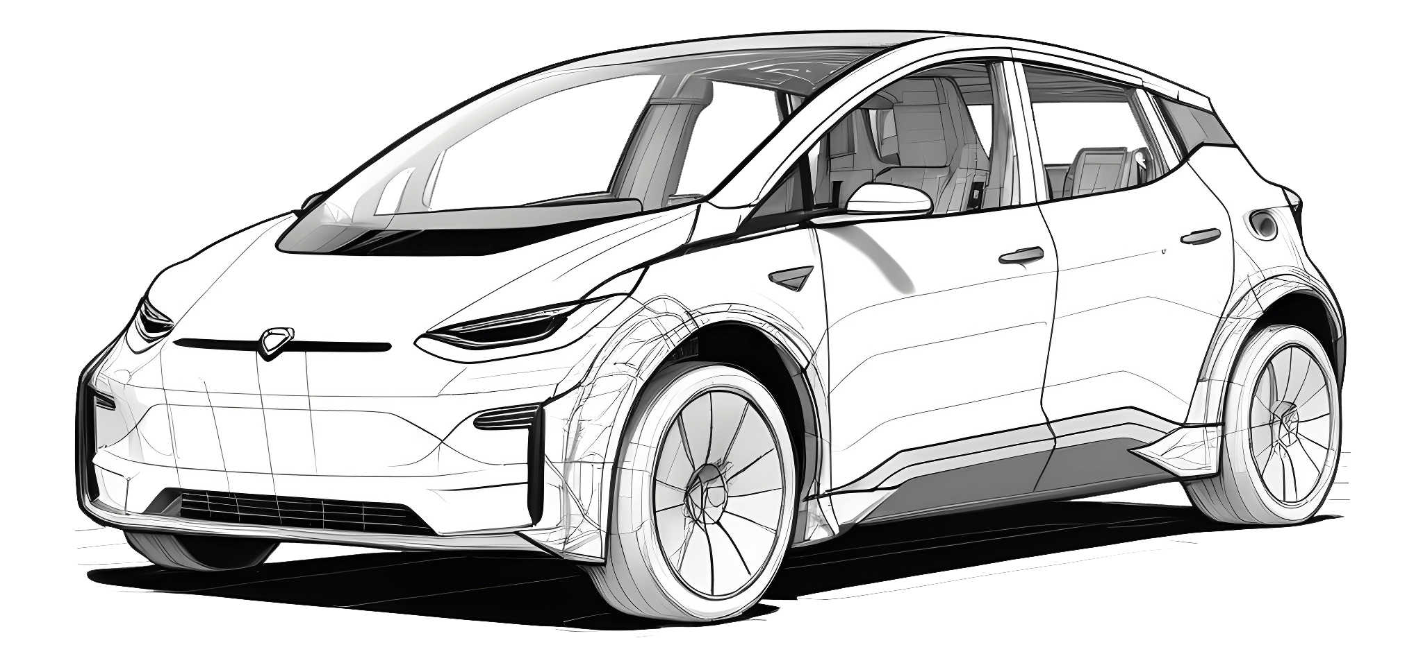
Power of Parallel Computing in Car Model Detection
Team 11
Angel N. Fernandes
Anish P. Navale

Slide 2
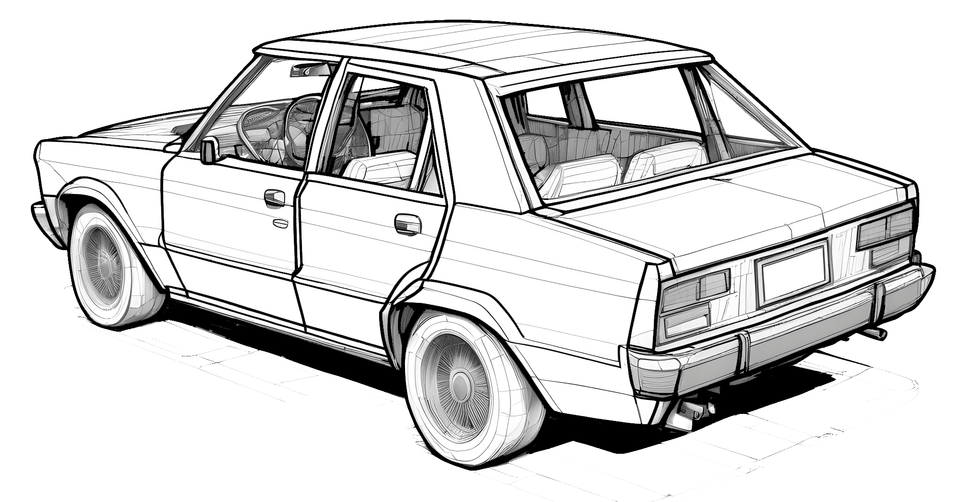
01
Introduction
Background, Motivation and Goal

Slide 3
Background
In the age of rapid tech advancement, the automotive industry leads innovation, using deep learning to improve vehicle design, safety, and more.
Identifying and categorizing cars accurately is key for applications like autonomous driving. Large datasets enable exploring deep learning's potential in car classification, driving further advancements.
Motivation
This research was inspired by the critical need for reliable car recognition technology in today's automotive landscape.
With the rising number of vehicles on the road, there is a growing demand for systems capable of accurately identifying and categorizing cars in various real-world scenarios.
These systems are essential for improving traffic flow, road safety, and advancing autonomous driving.
Goal
To utilize advanced deep learning techniques for car model classification and implement parallelization methods for concurrent data processing, with the goal of minimizing preparation time and maximizing efficiency.
To identify the optimal approach and parameters to achieve these objectives effectively.

Slide 4
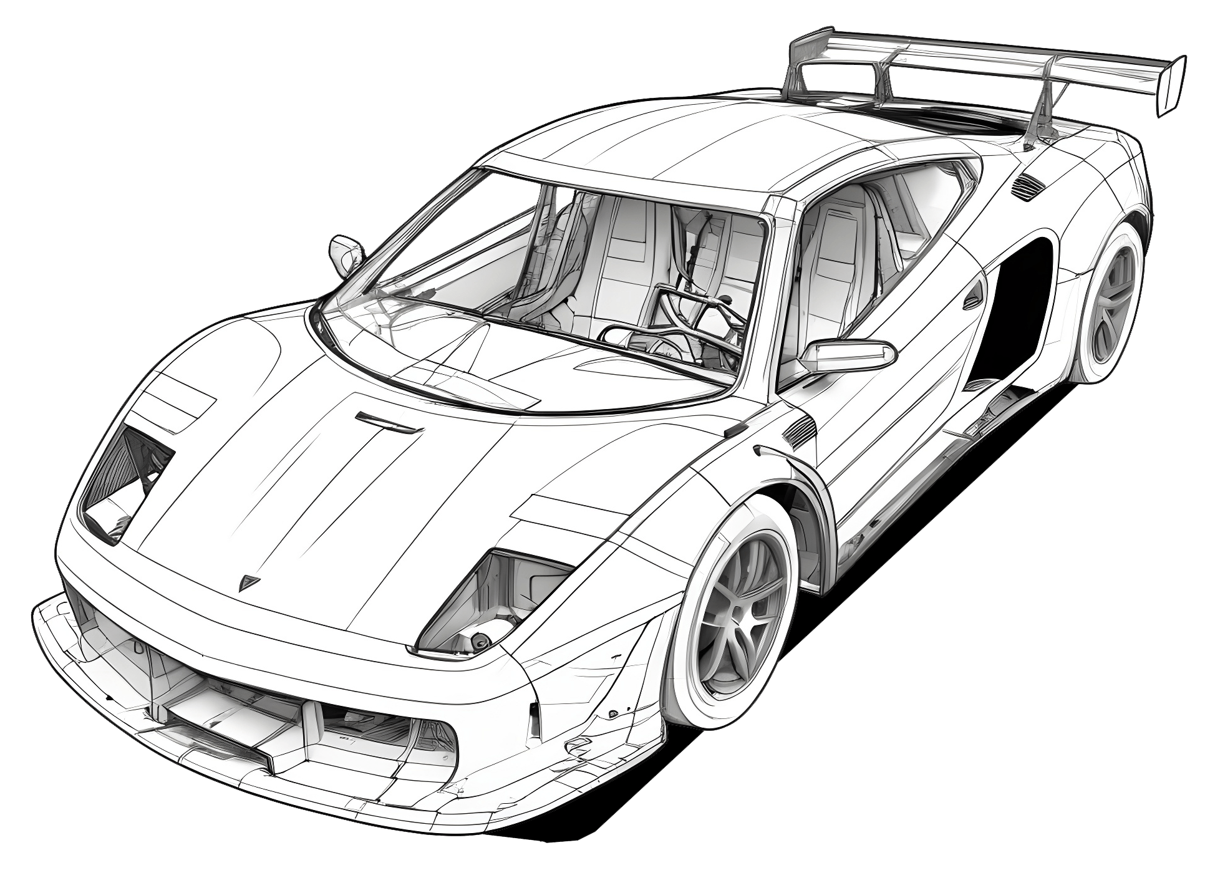
02
Dataset Description

Slide 5
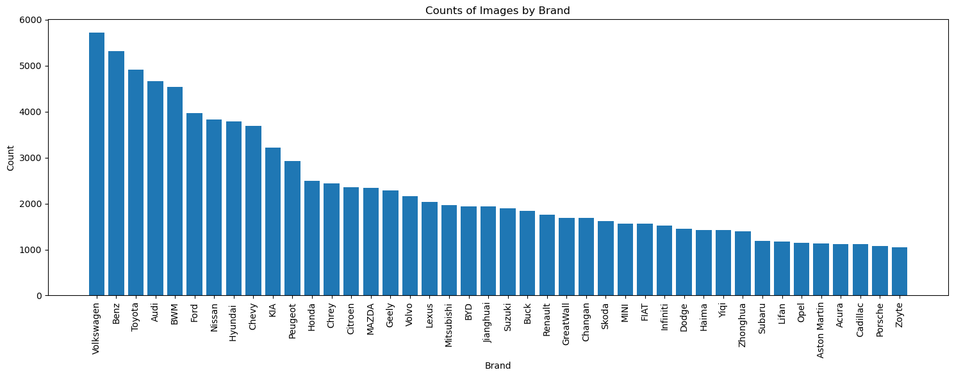
The dataset initially comprised of 1,36,726 images across 163 makes and 12 models.
Notes:
Since the dataset is huge, we decided to utilize a subset of data which is relevant. We did this by performing initial exploratory data analysis by reading in the data, and its respective attributes like Brand and Model Type. Data was combined by reading in the files ‘car_type.mat’ and ‘make_model_name.mat’.

Slide 6
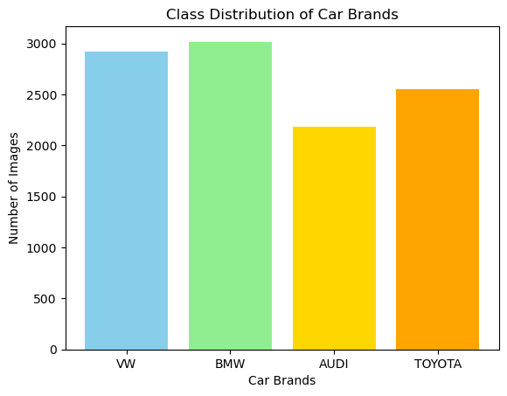
We reduced the working set to brands: Volkswagen, BMW, Audi, and Toyota.
The dataset consisted of 2919 images of VW, 3017 images of BMW, 2187 images of Audi, and 2551 images of Toyota.
Notes:
Anticipating a large computation time, we selected 4 brands having the highest number of images provided in the data across 4 model types. The brands are Audi, Volkswagen, BMW and Toyota and the 4 model types are SUV, Sedan, Hatchback and Sports. The number of Volkswagen images is 2919, the number of BMW images is 3017, the number of Audi images is 2187, and the number of Toyota images is 2551.

Slide 7
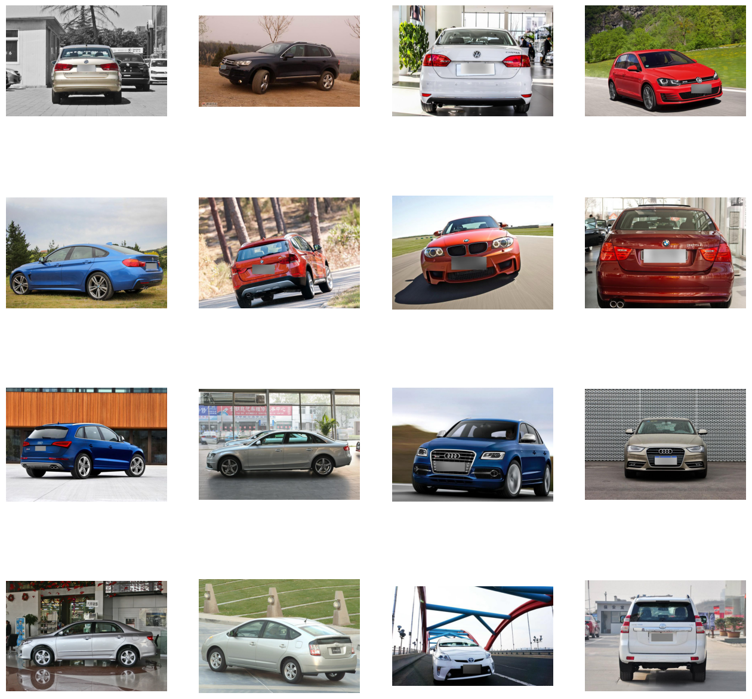
Notes:
Anticipating a large computation time, we selected 4 brands having the highest number of images provided in the data across 4 model types. The brands are Audi, Volkswagen, BMW and Toyota and the 4 model types are SUV, Sedan, Hatchback and Sports. The number of Volkswagen images is 2919, the number of BMW images is 3017, the number of Audi images is 2187, and the number of Toyota images is 2551.

Slide 8
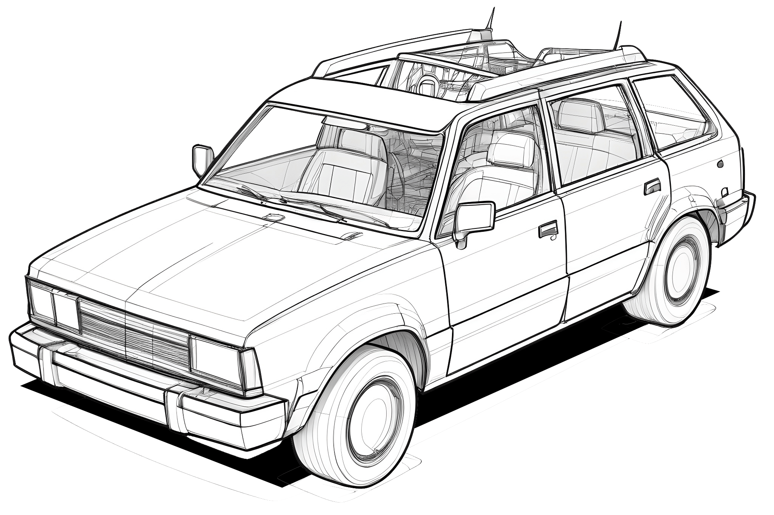
Methodologies
03

Slide 9
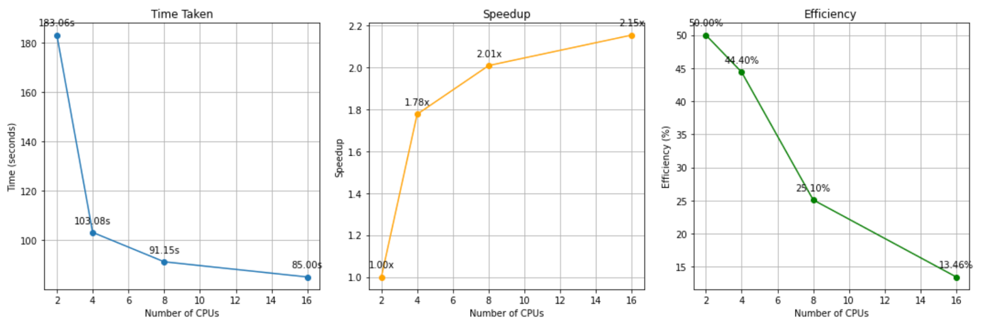
Data Preprocessing
Parallel Processing for Efficiency :
We take the number of desired processes as input and uses the multiprocessing.Pool module to distribute the copy_files task across the specified number of processes.
The outputs provided show the runtime of each process configuration, indicating that as the number of processes increases, the time taken to complete the copying task decreases.
For instance, when running with 8 processes, the execution time reduces to approximately 1.43 seconds, compared to 3.60 seconds with a single process.
Notes:
The code focuses on data splitting and augmentation by copying files from a main directory into training and testing directories for each class. The copy_files function is used to randomly select files from the source directory for each class and copy them to the corresponding target directories. If the number of files required exceeds the available files, all available files are copied. Parallel processing is used to expedite the copying process by dividing the task among multiple processes. The run_parallel_copy function manages this parallel execution, reducing the time taken to complete the task. For example, with 8 processes, the execution time is reduced to approximately 1.43 seconds, compared to 3.60 seconds with a single process. Following the creation of training and testing sets, the code creates a validation set by moving a specified percentage of images from the training set to a separate validation directory. The runtime outputs demonstrate the efficiency gains achieved through parallel processing. For example, with 8 processes, the time taken to create the validation set is significantly lower than 0.091 seconds with a single process. Data integrity maintenance is ensured by functions to clear target directories before each operation and restore images from the validation set back to the training set. These functions help maintain a consistent dataset structure and prevent contamination between different phases of the experiment.

Slide 10
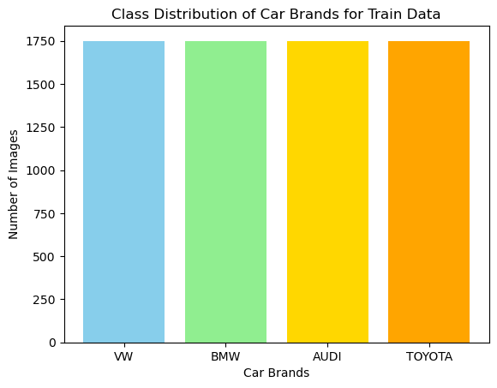
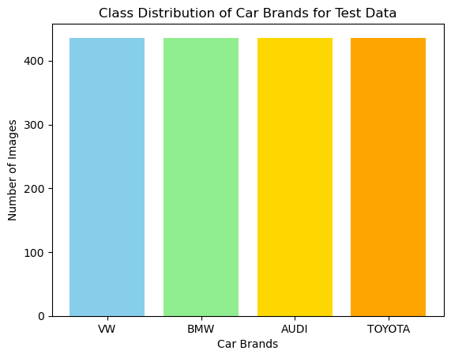
Data Preprocessing
Data Splitting and Augmentation:
To train the data, we chose an equal distribution of 1750 images per brand and to test the data, we chose 436 images per brand
The function randomly selects files from the source directory for each class and copies them to the corresponding target directories.
This process ensures that both training and testing sets have a balanced representation of each class.
Notes:
The code focuses on data splitting and augmentation by copying files from a main directory into training and testing directories for each class. The copy_files function is used to randomly select files from the source directory for each class and copy them to the corresponding target directories. If the number of files required exceeds the available files, all available files are copied. Parallel processing is used to expedite the copying process by dividing the task among multiple processes. The run_parallel_copy function manages this parallel execution, reducing the time taken to complete the task. For example, with 8 processes, the execution time is reduced to approximately 1.43 seconds, compared to 3.60 seconds with a single process. Following the creation of training and testing sets, the code creates a validation set by moving a specified percentage of images from the training set to a separate validation directory. The runtime outputs demonstrate the efficiency gains achieved through parallel processing. For example, with 8 processes, the time taken to create the validation set is significantly lower than 0.091 seconds with a single process. Data integrity maintenance is ensured by functions to clear target directories before each operation and restore images from the validation set back to the training set. These functions help maintain a consistent dataset structure and prevent contamination between different phases of the experiment.

Slide 11
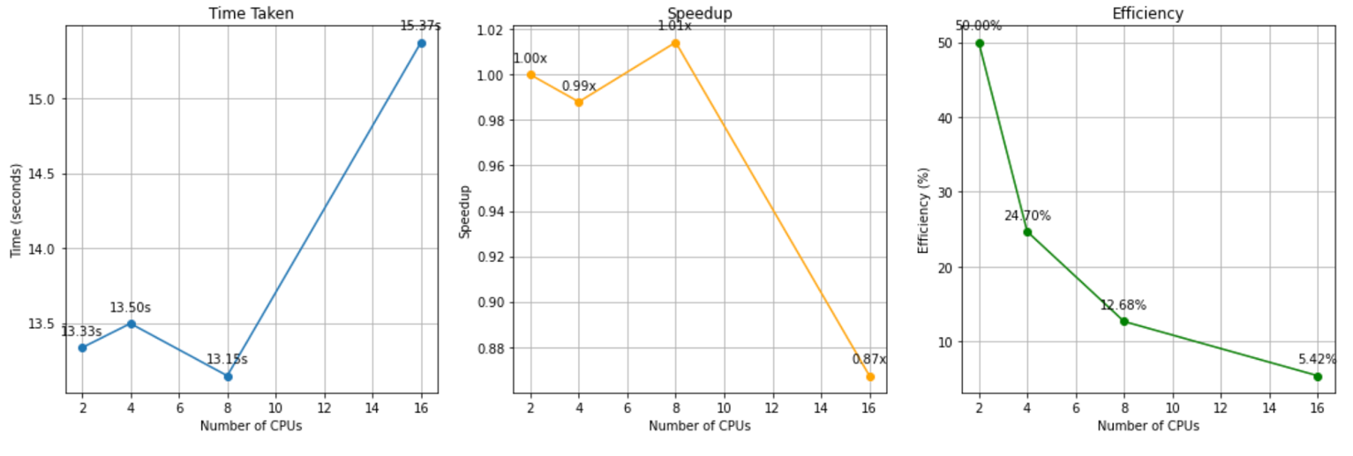
Data Preprocessing
Data Validation and Set Creation:
The move_images_to_validation function moves a specified percentage of images from the training set to a separate validation directory.
The runtime outputs demonstrate the efficiency gains achieved through parallel processing.
For instance, with 8 processes, the time taken to create the validation set is approximately 0.048 seconds, significantly lower compared to 0.091 seconds with a single process.
Notes:
The code focuses on data splitting and augmentation by copying files from a main directory into training and testing directories for each class. The copy_files function is used to randomly select files from the source directory for each class and copy them to the corresponding target directories. If the number of files required exceeds the available files, all available files are copied. Parallel processing is used to expedite the copying process by dividing the task among multiple processes. The run_parallel_copy function manages this parallel execution, reducing the time taken to complete the task. For example, with 8 processes, the execution time is reduced to approximately 1.43 seconds, compared to 3.60 seconds with a single process. Following the creation of training and testing sets, the code creates a validation set by moving a specified percentage of images from the training set to a separate validation directory. The runtime outputs demonstrate the efficiency gains achieved through parallel processing. For example, with 8 processes, the time taken to create the validation set is significantly lower than 0.091 seconds with a single process. Data integrity maintenance is ensured by functions to clear target directories before each operation and restore images from the validation set back to the training set. These functions help maintain a consistent dataset structure and prevent contamination between different phases of the experiment.

Slide 12
Model Development
The model development process utilized Python's multiprocessing module for parallelization on CPUs.
The script imports necessary libraries including torch, torchvision, and multiprocessing.
A custom dataset class, CustomDataset, is defined to handle loading and preprocessing of image data.
DataLoader objects are prepared using the prepare_dataloader function to facilitate efficient data loading.
The ResNet model is initialized using initialize_resnet_model, with the final fully connected layer modified for the specific classification task.
The optimizer (RMSprop) and loss function (CrossEntropyLoss) are initialized using initialize_optimizer_and_criterion.
The training procedure (train_resnet_model) involves iterating over epochs and optimizing the model's parameters using backpropagation.
The main function orchestrates the entire training process, including data loading, model initialization, training loop, and saving the best model.
Finally, the script utilizes multiprocessing to train the model with varying numbers of CPU cores, iterating through different core configurations to optimize performance.
Notes:
The training, validation, and testing datasets are loaded using the torchvision.datasets.ImageFolder module, which automatically organizes the data into class-specific folders. Prior to training, the input images undergo preprocessing transformations, including resizing to a standard size of 224x224 pixels and normalization using mean and standard deviation values derived from the ImageNet dataset. These transformations ensure that the input data is properly formatted and standardized before being fed into the model.
Model Definition and Initialization
The CNN model architecture employed in this implementation is ResNet-50, a deep residual network pretrained on the ImageNet dataset. The fully connected (fc) layer of the pre-trained ResNet-50 model is replaced with a new linear layer to accommodate the specific classification task at hand. The number of output classes is determined based on the number of classes present in the training dataset. This step initializes the model for subsequent training and evaluation.
Training
The model is trained over multiple epochs using stochastic gradient descent with the RMSprop optimizer. During each epoch, the training data loader is iterated over, and batches of images and corresponding labels are fed into the model. The model parameters are updated based on the calculated loss using the cross-entropy loss function. The training progress is visualized using the tqdm library, which displays a progress bar indicating the completion of each epoch and the current loss value.

Slide 13
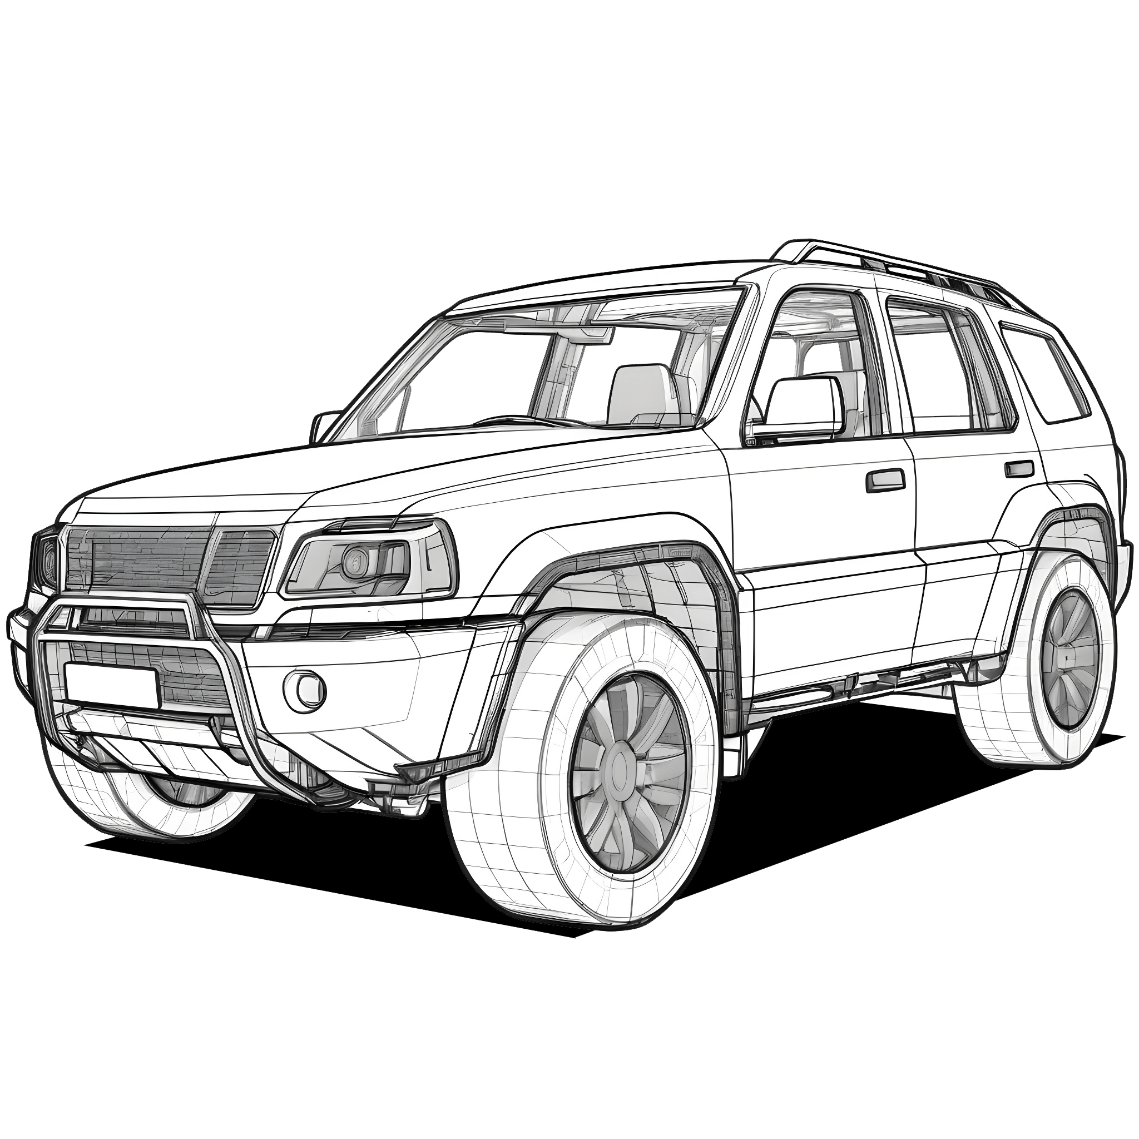
04
Analysis & Results

Slide 14
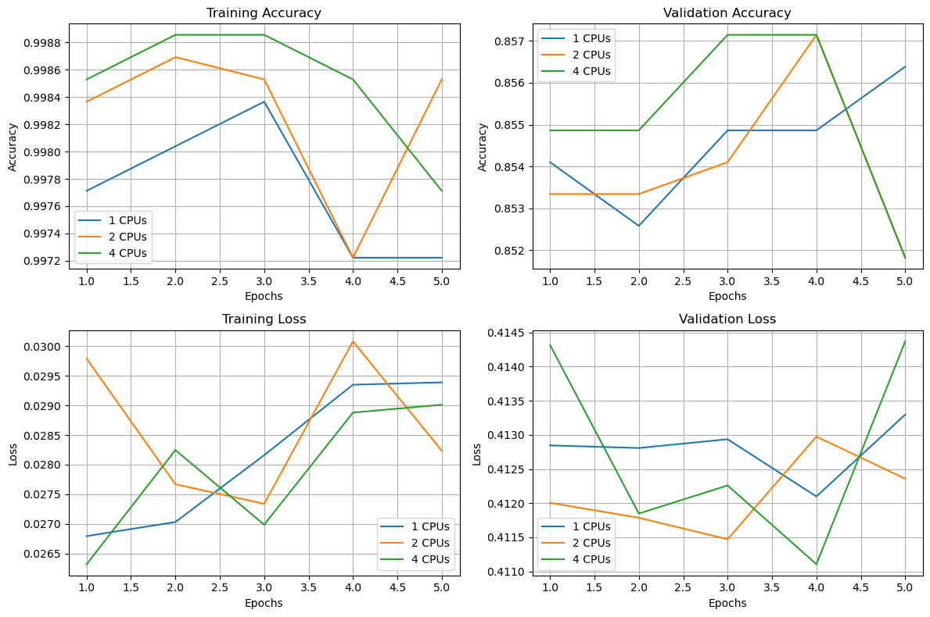
Training & Validation Loss
Notes:
The code focuses on data splitting and augmentation by copying files from a main directory into training and testing directories for each class. The copy_files function is used to randomly select files from the source directory for each class and copy them to the corresponding target directories. If the number of files required exceeds the available files, all available files are copied. Parallel processing is used to expedite the copying process by dividing the task among multiple processes. The run_parallel_copy function manages this parallel execution, reducing the time taken to complete the task. For example, with 8 processes, the execution time is reduced to approximately 1.43 seconds, compared to 3.60 seconds with a single process. Following the creation of training and testing sets, the code creates a validation set by moving a specified percentage of images from the training set to a separate validation directory. The runtime outputs demonstrate the efficiency gains achieved through parallel processing. For example, with 8 processes, the time taken to create the validation set is significantly lower than 0.091 seconds with a single process. Data integrity maintenance is ensured by functions to clear target directories before each operation and restore images from the validation set back to the training set. These functions help maintain a consistent dataset structure and prevent contamination between different phases of the experiment.

Slide 15
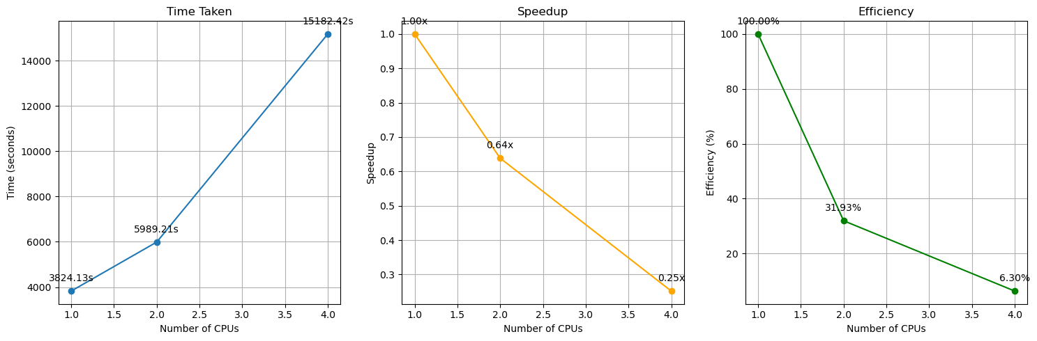
Multiprocessing

Slide 16
Model Development
Evaluation:
The CNN model undergoes evaluation on both validation and test datasets after training.
The process involves iterating over the data loader, computing the model's predictions, and comparing them with ground truth labels to calculate accuracy.
Results:
The model achieved promising results in classification accuracy, with test accuracy measuring at 74.20% and validation accuracy at 69.00%.
Notes:
Evaluation
Following training, the trained model is evaluated on both the validation and test datasets to assess its performance. For each dataset, the evaluation process involves iterating over the respective data loader, computing the model's predictions, and comparing them with the ground truth labels to calculate the accuracy. Similar to the training process, the evaluation progress is visualized using tqdm, which provides real-time updates on the accuracy achieved by the model.
Results
Upon completion of the training and evaluation process, the CNN model achieved promising results in terms of classification accuracy on both the test and validation datasets. The test accuracy, representing the model's performance on unseen data, was measured at approximately 74.20%. Similarly, the validation accuracy, which assesses the model's generalization ability on a separate dataset, was found to be approximately 69.00%.

Slide 17
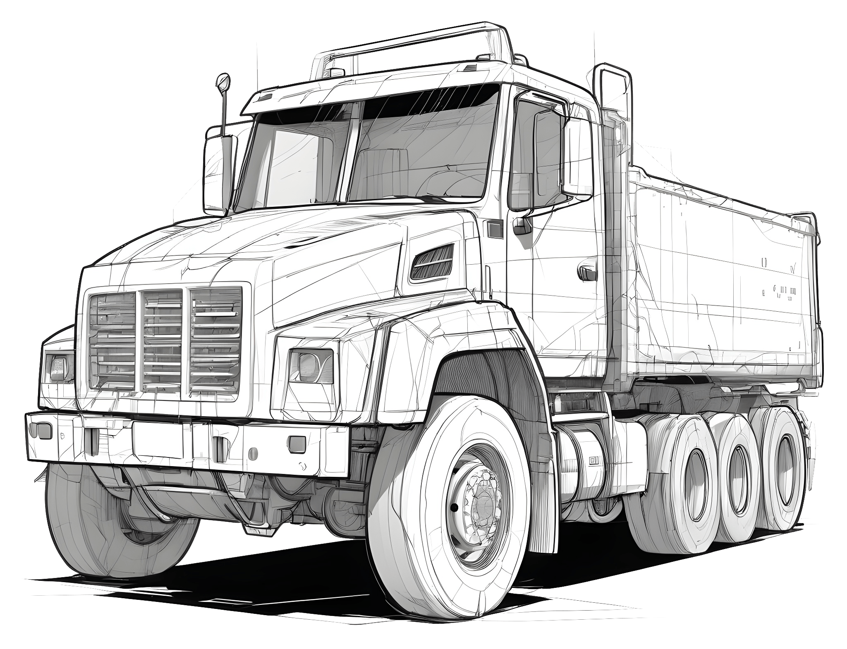
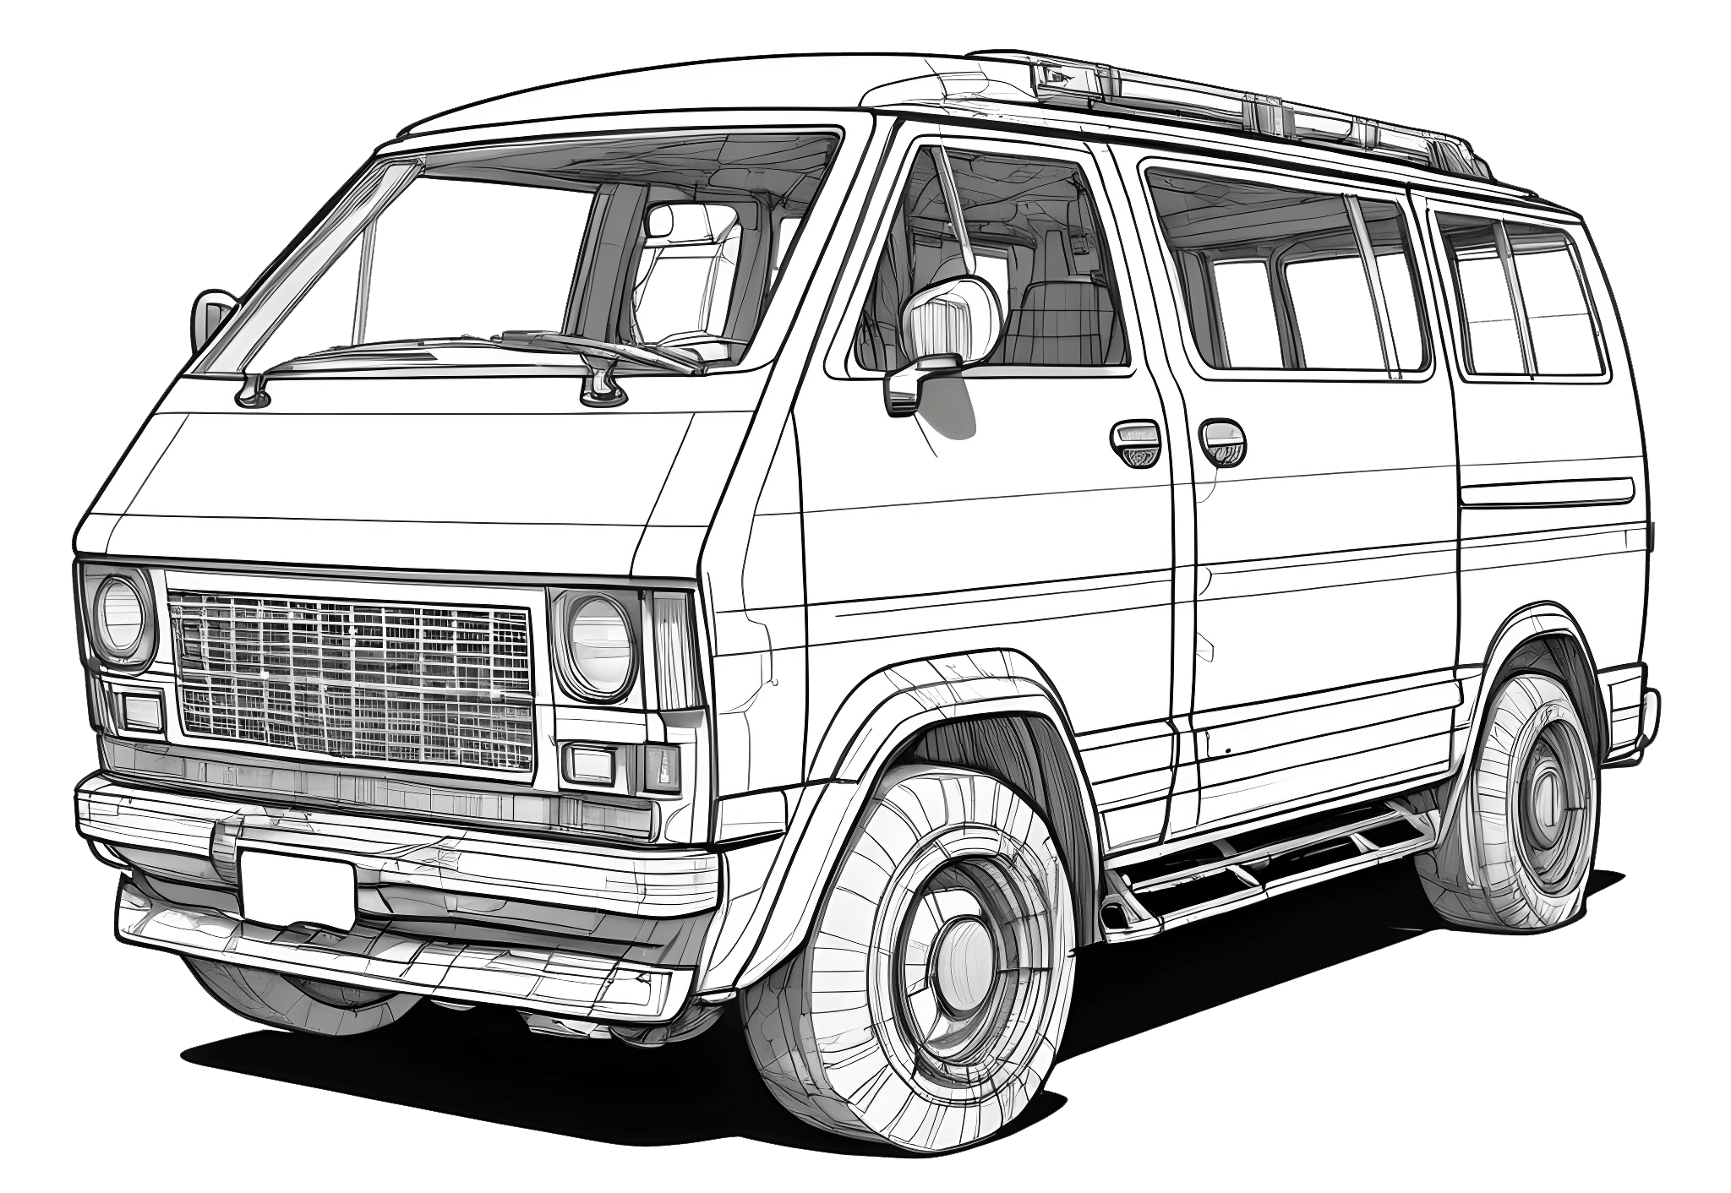
Conclusion
The study demonstrates the use of efficient data processing techniques, such as parallel processing, to split a dataset into training, testing, and validation sets for machine learning models.
The results reveal performance gains achieved through parallelization, emphasizing the importance of optimization in large-scale data processing tasks.
This methodology is applied to train and evaluate CNN models using PyTorch, promoting reproducibility and further experimentation in computer vision.
References
Kaggle Car Dataset: https://www.kaggle.com/datasets/renancostaalencar/compcars/data
Kaggle Jupyter Notebook: https://www.kaggle.com/code/kitaiskypanda/mcs-data-mining
ResNet50 Documentation: https://pytorch.org/vision/main/models/generated/torchvision.models.resnet50.html
ResNet GitHub: https://github.com/pytorch/vision/blob/main/torchvision/models/resnet.py

Slide 18
Thanks!

